Slide 1


INTRODUCTION
To Telecommunications and Networking
An Instructor-led Course Designed Specifically for FDIC Risk Management Examiners

Slide 2
Our Goal of this Week
Is to begin cracking this code
What are all these things? Which of them have I seen before?
Which do I use myself, and how, and for what?
Why switches, routers, firewalls, modems, and other boxes?
What do they do, and how do they work?
What standards govern their behavior and operation?
What’s in the cloud-things, and lines that show connections?
Are all the connections alike or equivalent?
What is safe and what is not?
Where are the risks? There is always risk!
What questions can I ask to learn about a bank’s network?
How can I know if my banks are using best practices?
Is the banking industry taking advantage of available value?

Slide 3
Introductions
We have 4.5 days together this week, so I’ll go first:
My name is Matt Kolon, I’m a Senior MTS at Hill Associates
I’m a long-time networking and telecom geek
I’ve worked for Cisco, Juniper, and Brocade as well as Hill Associates
From 2005 to 2017 I lived in 香港, 北京, and 東京
Now I live in Underhill, Vermont where I ski and ride my bikes a lot.
This week I’d like us to find places where risk is hiding in bank networks!
Maybe we can also share some general networking knowledge, too...
Please tell us about you!
Where do you live and work?
What’s your role?
What do you do for fun?
What would you like to take away from this course?

Slide 4

Overall Goals of this Course
Explore the technical aspects of voice and data networks
Learn the common network technologies used in banks
Expand and define common acronyms and terminology
Discuss current trends in telecommunications and networking
Raise you comfort level with telecommunications and networking in conversations bank IT staff
Know where the risk is and what to do about it
Discuss where networking may be in a few years

Slide 5

Agenda
Introduction to data networks and the telecom industry
Communication models (OSI RM, the Internet protocol suite, and the modern five-layer telecom model)
Working our way from the Physical Layer up through the Application Services Layer
Voice networks
Network security
Applying our knowledge to bank networks
Emerging technologies

Slide 6
The Big Picture

Slide 7

The Communications Challenge Today
Today’s communications challenge is to create an infrastructure that will deliver information any time, to any place, via any device
Meeting this challenge involves many moving parts and players, and many networks
Constant change is the name of the game
This change occurs in many domains

Slide 8
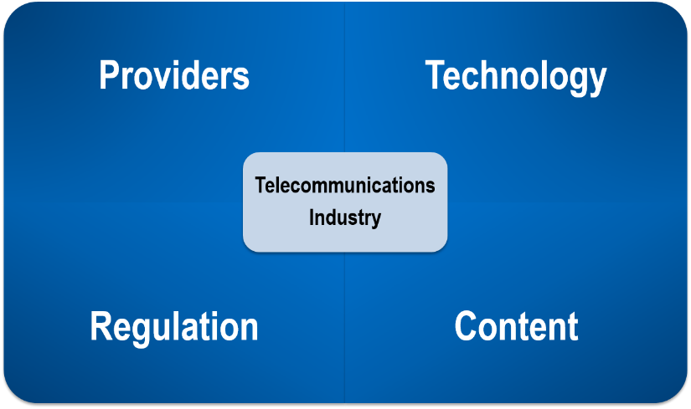
Telecommunications Domains

Slide 9

Regulation
Various forms of regulation exist in telecommunications and networking
Wired and wireless networks in the US fall under federal, state and international jurisdictions, areas covered may include
Licensing
Availability
Reliability
Customer support
Technology
Provider interconnection
Security

Slide 10

The Voice Network
Telephone network technology has undergone major replacement every 20–30 years
In the past, technology replacement was based on economics driving when replacement took place
Last move was to VoIP, drivers included
Economics
Data now more important than voice
Mobility adds convenience
Demise of the wireline phone
Regulation
Reduced need
Applications
Integration with conferencing and IM

Slide 11

Data Networks
Computer technology has evolved at an unprecedented rate
Businesses first used computers in the 1960s and all communication used private connections of modified voice circuits
Public data networking appeared in the 1970s, but the real change occurred with the commercialization of the internet in the 1990s
Network technology has moved from proprietary to internet-based, even for private networks
The internet continues to change everything
Wireless access has grown in importance

Slide 12
Video Networks
Video networks started with over the air broadcast of television
Overtime most households moved to pay-tv to get access to more and more content
Technology has moved viewing from live to when convenient and from the TV to a wide variety of devices
Increasing drive to internet distribution
Traditional players trying to figure out their roles
Content owners exploring new distribution models
Streaming services fighting for eyeballs
TVs have had to become smarter
Business video
Was expensive and required specialized equipment
Now we have many affordable options on the desktop

Slide 13
Technology
Innovation has played a critical role in telecommunications and networking
Standards also play a significant role
Together they drive new capabilities and interoperability
Historically security has been an afterthought
Increasingly security is becoming an integral part of new products and services
What would our world be like if other technologies had advanced at the same rate? How fast would cars be? What would be the travel time from NYC to London?

Slide 14
Who are the Major Players in Telecom?
Your table will be assigned a domain in telecommunications. Create a list of 3-5 players in your assigned domain.
Regulation
Voice
Internet services
Video – consumer
Video – business
Technology

Slide 15

Let me ask you to…
Name three technologies that have revolutionized banking

Slide 16
Models and Layers

Slide 17
The Language of Networking
Networking is complex
We have developed approaches to describe and build networks, these include
Protocols
Network models
Layers
Together these concepts provide the basis for the networkers’ lexicon
Familiarity will help in your conversations with a bank’s network team

Slide 18
Protocols
To communicate, we must have agreements
Example: Don’t interrupt
Example: Speak English
Example: Say, “Please”
Agreements that facilitate communication are called protocols
The study of communications is the study of protocols
The study of data communications is the study of data and network protocols
The complete set of protocols used in a particular network environment is known as a protocol suite

Slide 19

Models
A hypothetical description of a complex entity or process
Identifies the major elements and their relationship to one another
Does not provide implementation details
An architecture
Model of a home
Walls, roof, floors, doorways, windows, types of room
Does not include specific materials, design, construction
Networking model is about the functions that must be present in a network and their relationship to one another

Slide 20
Layering
Layering breaks a big problem into smaller pieces
Large number of protocols required for interoperability between two applications
Break protocols into subsets, each of which addresses specific, closely related issues
Each layer
Provides a well-defined set of services to the layers above it
Receives services from the layer below it
Knows the set of services that are provided to it
Does not know how those services are provided

Slide 21
Two Models Drive Modern Networks
OSI Reference Model
Original networking model work began in the 1970s
Standardized by ISO in the 1980s
Seven-layer model designed for interoperability
Source for much of the networking terminology
Internet Protocol Suite
Framework created for data communications networks
Evolved from work spurred by DARPA and the ARPANET
The Internet Protocol and Transmission Control Protocol were the foundation of the Suite
With the broad adoption of the internet the Internet Protocol Suite has become the core protocols used in today’s networks
Familiarity with both models essential for understanding the terminology of networking

Slide 22
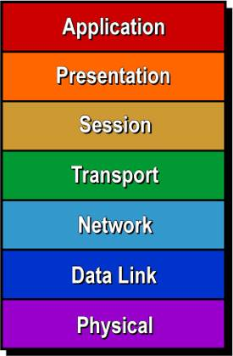
Understanding the OSI RM Layers
Where They Live
What They Do
Interoperability
(Meaningful Work)
End-to-End Layers
(End Systems)
Connectivity (Successful Exchange)
Chained Layers
(All Systems)

Slide 23
A Closer Look at the Layers
Application
Information Semantics (email, Web, voice)
Presentation
Information syntax (compression, encryption)
Session
Dialogue/session control (logon, checkpointing)
Transport
End-to-end correctness (sequencing, loss)
Network
Routing (addressing, congestion control)
Data Link
Node-to-node correctness (access, bit errors)
Physical
Bit transmission (distance, speed, medium)

Slide 24


OSI Provides a Reference Framework
Application
Application
Presentation
Presentation
Session
Session
Transport
Transport
Network
Network
Network
Data Link
Data Link
Data Link
Data Link
Physical
Physical
Physical
Physical
Gives us a language to talk about data network technologies

Slide 25
The TCP/IP Network View
Application Services
Application Services
Transport
Transport
Internet
Internet
Internet
Network Interface
Network Interface
Network Interface
Network Interface

Slide 26
Bringing the Models Together
Application
Application Services
Presentation
Session
Transport
Transport
Network
Internet
Data Link
Network Interface
Physical

Slide 27
Let me ask you…
Have you ever heard a bank network team refer to any of the layers in either model?
If so, what layer and what was the context?

Slide 28
Telecommunications Terminology
IT use the OSI model and TCP/IP as short cuts to describe network elements
Common use include
Layer 1 – Physical (wired and wireless)
Layer 2 – Data Link (Ethernet combines L1 and L2 elements)
Layer 3 – Network (IP)
Layer 4 – Transport (TCP/UDP)
Layer 7 – Application Services (HTTPS, SMTP etc.)
Familiarity will help you understand a techie discussion and join the club!

Slide 29

Application Walkthrough
Let’s look at an application we use everyday: Email
Things we need
An application like Outlook
Proprietary application
Composition/editing
Viewer
Repository
Filtering
Standard communication protocols
Email format
Communications to/from the post office

Slide 30
Simple Mail Transfer Protocol
Email format
Header
Addressing
Body
Attachments
Connection to server
Usually to corporate server
Server may provide additional functions
Server to server communications
Receiving emails from corporate server
Commonly use POP or IMAP
Communication path to server
Email
Client
SMTP
Email
Server
POP or IMAP
Email
Server
SMTP
Email
Server
SMTP

Slide 31
Transmission Control Protocol
Manages connection to the destination server
Addressing
Data transfer
Receipt acknowledgement
Disconnects from the server
Messages need to get to the destination server
Email
Server
SMTP
Email
Server
Sender
TCP
Receiver

Slide 32

Email
Server
Internet Protocol
Used to move packets between to the destination server
Implemented in routers that are the gateways between networks
Packet format
Header
Addressing
Routing protocols used to determine how router forward packets
First step is to get to get to the router
SMTP
Email
Server
Sender
Receiver
TCP
Router
Router
IP
IP
Intermediate
Networks

Slide 33
SMTP
Ethernet
LAN connecting devices in a network as defined by the IP address
To leave the network data needs to cross the LAN (link) to the exit (router/gateway)
Defines
Addressing
Frame format
Error detection
Physical connection
TCP
IP
IP
Ethernet
Ethernet
Client or Server
Router

Slide 34
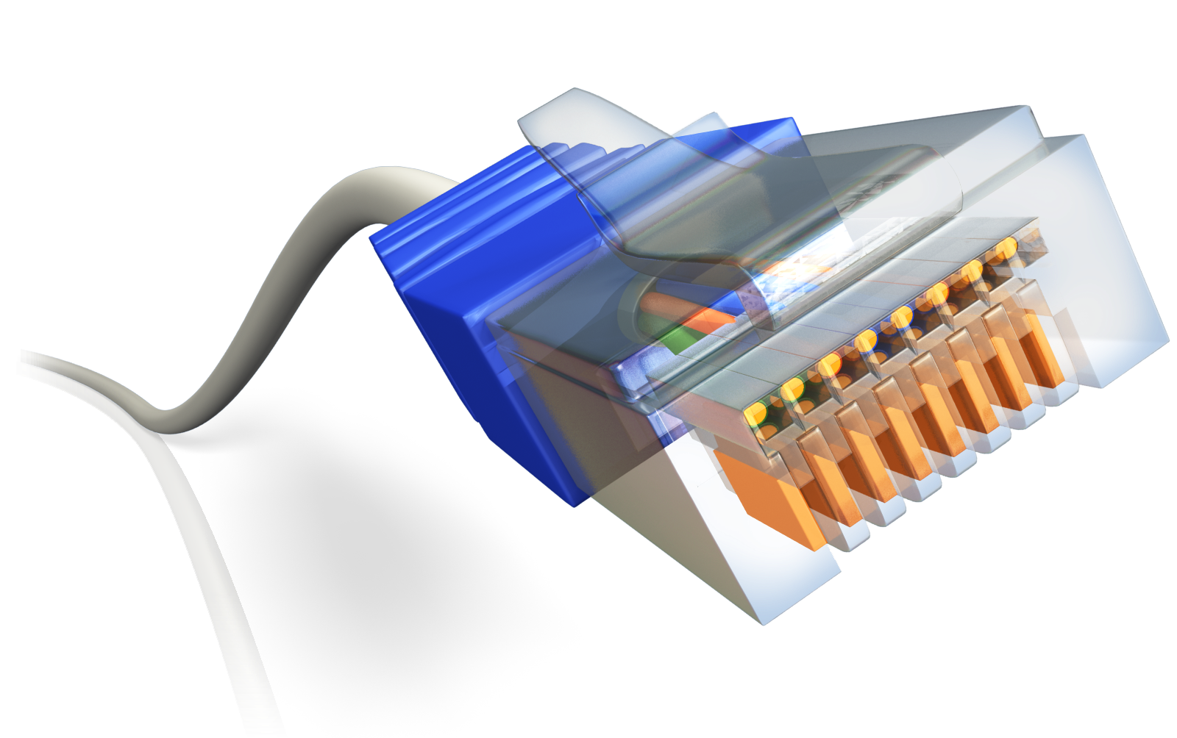
LAN physical connection
Cabling
Connectors
Signal format

Slide 35
Observations
Breaking down the act of communications into steps simplifies implementation and understanding
Functionality for a specific step may be replaced by a new approach without impacting the other steps
Lots of addressing!
Implemented in different places
Application – format (SMTP)
Operating system – connection and routing (TCP/IP)
Hardware – link (Ethernet)

Slide 36
The Physical Layer

Slide 37



Physical Layer
Provides transmission of information between devices
Many forms of connection are available to choose from
Twisted
Pair
Coaxial
Cable
Optical
Fiber
Wireless

Slide 38


Analog and Digital
Information is classified as analog or digital
Analog information can take on an infinite number of values in a continuum
Digital can assume only a discrete (limited) set of values

Slide 39

Bits
Binary digit (bit)
A bit is a single number that has only two values: one (1) and zero (0)
The native language of transistor-based computing systems
A bit can also take on any meaning that is two-state
Yes, no
True, false
On, off
Data communications is about transmission of bits between two systems
Old analog systems have moved to digitization of data
Voice in phone calls
Music
Video in TV and streaming

Slide 40
Modulation
Modulate means “to change or manipulate”
In telecommunications, modulation is the act of making changes in a transmitted signal so that it conveys information
Simple examples include
Traffic lights
Steady red means stop
Blinking red means stop—then you can go
Dial tone (it’s a landline thing)
Dial tone tells you the phone is ready for use
Stutter dial-tone (the dial tone has been modulated) tells you that you have voice mail (and the phone is ready for use)
Back-up horn on a truck
The regular beep tells people the truck is backing up
Speeding up the beep (the beep is being modulated) tells the driver how close he/she is to an object (and tells people the truck is backing up)

Slide 41
Analog vs. Digital: Signaling
Signaling is analog if the signal transmitted can take on any value in a continuum
Analog information can be sent directly as an analog signal
Digital information is transmitted by modulating an analog “carrier”
Device is called a modem
Signaling is digital if the signal transmitted can take on only discrete states
Analog information must be approximated by a digital information stream for transmission
Device is called a codec
Digital information can be sent directly

Slide 42
Let me ask you to…
Identify examples of common analog and digital transmission systems
Provide analog information we store and transmit in digital form

Slide 43

Transmission Rate
Transmission rate is the amount of data per second
Based on three factors
Bandwidth of the channel
Channel: A communication path
Passband: Range of frequencies in a channel
Bandwidth: Number of frequencies in a channel
Impairments on the channel
Noise: Random impairments
Distortion: Fixed impairments
Signaling method used
Analog: Frequency modulation (FM), amplitude modulation (AM)
Digital: AMI, B8ZS, Manchester, 4B/5B
Measured in bits (or Bytes) per second (i.e., bps or Bps)

Slide 44

Multiplexing
A technique to share communications capacity
Various methods in use
Frequency division multiplexing (radio/TV)
Time division multiplexing (programming/PSTN)
Wavelength division multiplexing (optical transport)
Code division multiplexing (cellular networks)

Slide 45
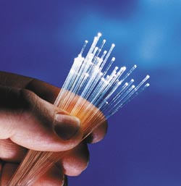
Media
In modern networks, information is transmitted as
Electrical energy (copper)
Light (optics, wireless)
Electromagnetic energy (wireless)
The medium provides an infrastructure for the transmission of information
The nature of the medium dictates its transmission characteristics
Attenuation
Susceptibility to transmission impairments
Carrying capacity

Slide 46
Media Options
Media
Wired
Wireless
Optical
Electrical
Optical
Radio Frequency
Single Mode Fiber
Multi- Mode Fiber
Twisted Pair
Coaxial Cable
Carrier- Based
Spread Spectrum

Slide 47
The Data Link Layer

Slide 48
Data Link Layer
Connects devices on a shared link
Data is sent in a frame
Common topologies are:
Point-to-Point
Any-to-Any
Examples
Point-to-Point Protocol
Ethernet
DOCSIS

Slide 49






Common Link Topologies
Point-to-Point
Any-to-Any
internet
Access
Data Link Functions
Framing
Addressing
Error check

Slide 50
Point-to-Point Protocol (PPP)
Commonly found on leased (private) lines and dial-access
Features
Framing (synchronization, data delimiting, transparency)
Additional capabilities
Authentication
Compression
IP address configuration
Multilink operation (MLPPP required) enables multiple channels to carry single data streams (inverse multiplexing)
internet
PPP

Slide 51
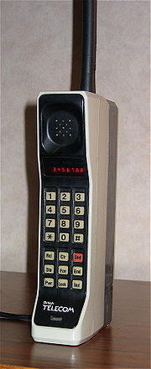
Cellular (Mobile) Networks
Many similarities to Wi-Fi
Specific bands allocated for the service
Multiple generations of the technology with each improving performance
Bands vary by country
Current generations have added new bands to increase capacity
Frequency (channel in Wi-Fi) reuse provides coverage in a wide area
Some differences
Original application was voice, data added over time
Handoff between cells creates WAN
Protocols to interconnect carrier networks part of the standards
Spectrum used requires a license

Slide 52
Cellular Network Evolution
Analog to digital
Voice to data
Single frequency band to multiple bands (varies by country)
Multiple technology standards globally to one
Increased use of fixed wireless access (FWA) for residential and business internet access
Move to edge computing to support low latency applications (industrial controls and self-driving cars being examples)

Slide 53




Banking Networks
Customers
WFH
Service
Providers
internet
Branches
Private
Network
HQ/datacenter

Slide 54
Inside the Branch
What devices do we have in the branch?
How are they used in supporting operations?
What applications do they access and where are they located?
How are they connected?

Slide 55
Ethernet
Ethernet is the wired LAN technology of choice
Standards created by the IEEE 802 Committee
Equivalent to the Physical and Data Link Layers of the OSI model and the Network Interface in the Internet Protocol Suite
A variety of Physical Layer options meet a wide variety of application needs
Coaxial cable
Twisted pair
Optical fiber

Slide 56
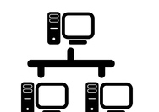

Ethernet Evolution
Ethernet LAN
Invented
IEEE 802.3 LAN
Standards
MEF WAN
Standards
1973
1980
2001
1973 to early 1980s
1980s
1990s to present day
Hub
Switch

Slide 57
Some Popular Ethernet Physical Layers
Standard | Length | Cable
10BASE-T | 100 m | Cat 3, 4, 5 UTP
100BASE-TX | 100 m | Cat 5 UTP
1000BASE-SX | 2000 m | MMF
1000BASE-LX | 3000 m | SMF
1000BASE-T | 100 m | Cat 5e, 6, 7 UTP

Slide 58
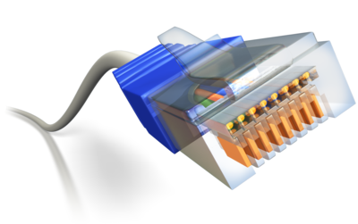
Typical Ethernet LAN
Most devices use a standard Ethernet chipset and use twisted pair connections
Autosensing selects speed between 10, 100 and 1000 Mbps
Connections go from the desk to a patch panel or switch
Allows different speeds on its ports
Provides the ability to have older devices in the same LAN as newer ones, such an old laser printer that only supports 100 Mbps
Switches can be interconnected
Twisted pair if close and on the same floor
Optical fiber used when further apart or on different floors

Slide 59
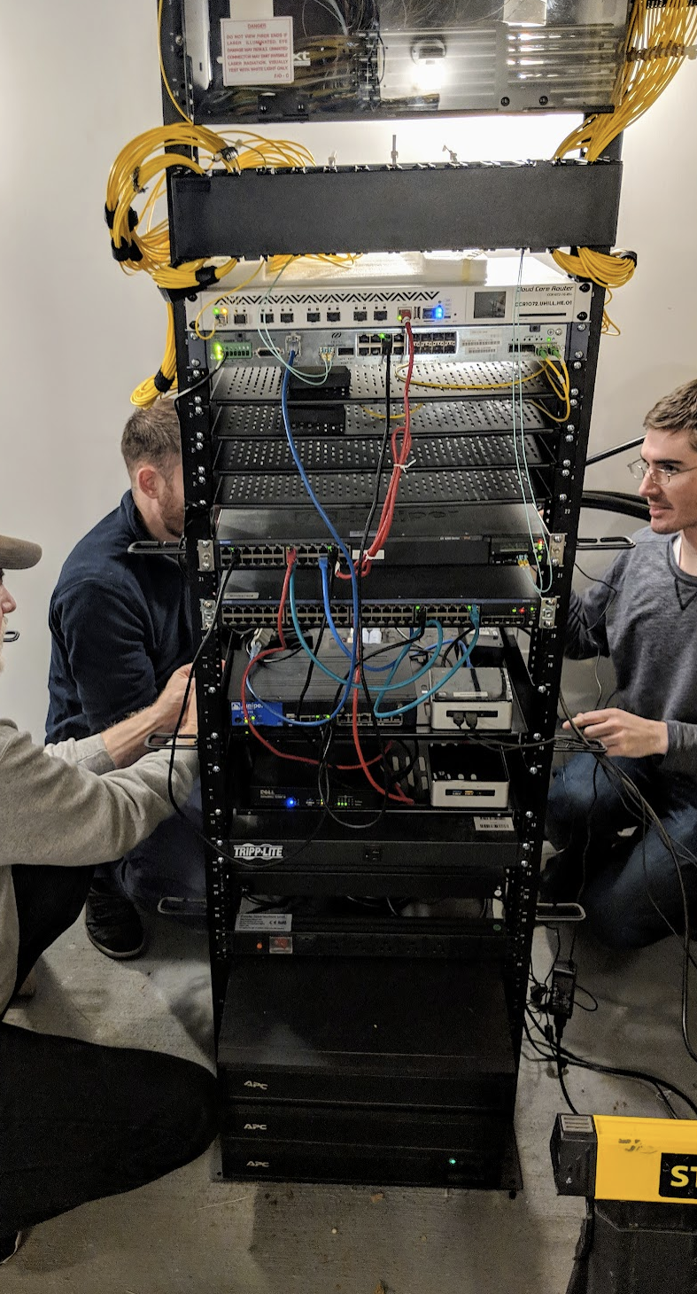
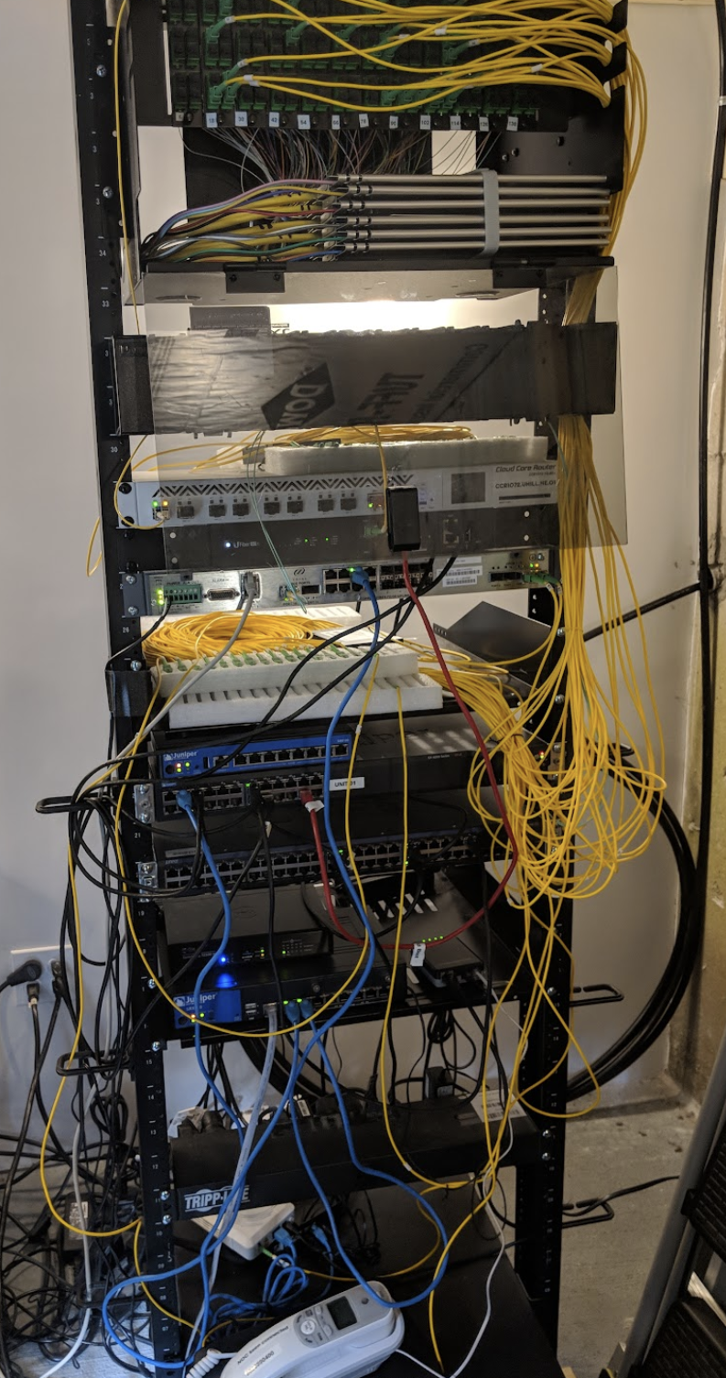
Structured Cabling
Which cabling job is better?
What might the cabling say about the IT team?
What do you see in the banks?

Slide 60
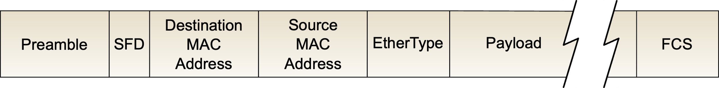
Ethernet Frame
Ethernet LANs allow any device on the LAN to talk to any other device on the LAN (any-to-any)
Addresses are needed to identify who the information is for
Ethernet frames include an address (referred to as the MAC address)
MAC address is assigned by device manufacturer

Slide 61
Let me ask you…
Do all the devices in the branch need to be able to see one another?
Should we create multiple zones (LANs) to separate devices/functions?

Slide 62
Multiple LAN Configuration
Allows traffic segmentation, for example data and voice
Simplest way to create multiple LANs (networks) is to have separate physical networks, requires
Multiple cable drops to the desk
Switches for each LAN
Separate inter-switch (trunk) connections for each LAN
Note each LAN (network) will have its own block of IP addresses assigned to it, more on this later
What if we could use one infrastructure and create multiple logical LANs to create separate segments?

Slide 63
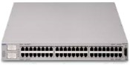

Virtual LANs (VLANs)
VLAN 1
Personnel
VLAN 2
Engineering
Switch
From B ⇒ All
From B ⇒ All
From B ⇒ All
From B ⇒ All
From B ⇒ All
From B ⇒ All
From B ⇒ All
From B ⇒ All
From B ⇒ All
A
From B ⇒ All
B
C
D
E
F
G
H
From B ⇒ E
From B ⇒ E
From B ⇒ All
Separates End Systems

Slide 64
VLANs
Logically creates multiple LANs within a switch
Tags used between switches to identify which LAN the frame belongs to
Configured on the switches
Change requires software update versus physical connection change for separate switches
Centralizes switch management

Slide 65
Let me ask you…
Where might you see VLANs used in a bank?
How do VLANs make an examiner’s life easier or harder?

Slide 66

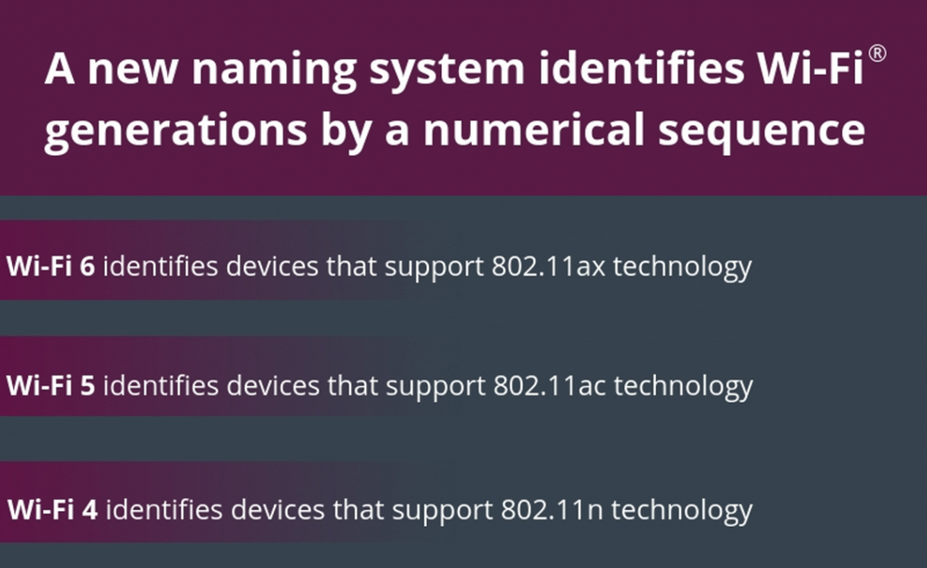
Wi-Fi
As ubiquitous as Ethernet in the LAN now
Part of IEEE 802.x family of LAN standards
802.11 is the IEEE name, but we just say Wi-Fi
The Wi-Fi Alliance is helping keep things simple
Theoretical speeds run to multi-gigabits, but the reality is usually slower
Huge variations in experience and management between vendors
Ethernet frame with Wi-Fi extras

Slide 67
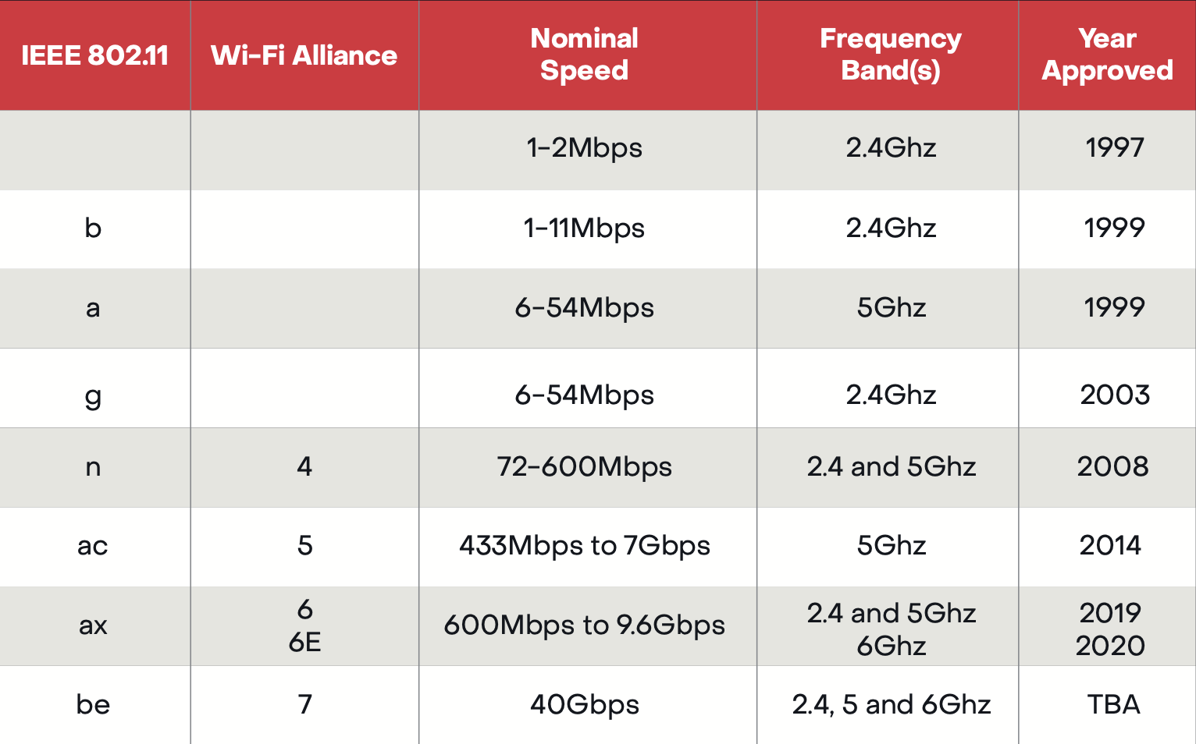
Wi-Fi Standards

Slide 68
Bands and Channels - 2.4 Ghz

Slide 69
2.4 GHz Channel Reuse

Slide 70
Service Set Identifier (SSID)
Sometimes referred to as a network name in Wi-Fi
Clients connect to a specific SSID
Multiple SSIDs may exist in Wi-Fi channel
Used to create multiple logical networks
FDIC CU and FDIC Guest being good examples
AP broadcasts name so devices can join
Like VLAN concept with client required to join
Sometimes an SSID may not be broadcast to hide the network

Slide 71

802.11 Security Issues
Unbounded nature of the medium
Need for encryption and authentication
Original goal to be “equivalent” to wired LAN
Service set identifiers (broadcast by access point)
Wired equivalent privacy (WEP)
Turned off by default
No user authentication (MAC address only)
WEP problems
64-bit RC4 encryption
24-bit known initialization vector (IV) plus 40-bit secret key
RC4 itself considered relatively weak
No key distribution system
All nodes share same key
No longer supported

Slide 72
Wi-Fi Protected Access (WPA3)
Ratified by Wi-Fi Alliance January 2018 as a replacement for WPA2
Based on a subset of IEEE 802.11i
Designed for use with an IEEE 802.1X authentication server
Different 192-bit key distribution to each user
Temporal Key Integrity Protocol (TKIP)
Dynamically changes keys as the system is used
Improved payload integrity
Stronger, safer
Many APs still support WPA2 along with WPA3

Slide 73
Some Wi-Fi Words: What do they Mean?
Typical specs for a new Wi-Fi device might be:
Wi-Fi 6E certified
2x2/4x4/2x2 MIMO
2.4 Ghz 20, 40 Mhz channels
5 Ghz 20, 40, 80 Mhz channels
6 Ghz 20, 40, 80, 160 Mhz channels
UltraMeshSM technology
WPA2/WPA3
Maximum speeds based on channel width are:
150 Mbps at 20 Mhz
300 Mbps at 40 Mhz
600 Mbps at 80 Mhz
1.2 Gbps at 160 Mhz

Slide 74
Let me ask you…
How do banks use Wi-Fi?
What risks are associated with Wi-Fi?

Slide 75
Now We Have LANs
LANs provide links between devices within a network
What makes the network a network?
Common link
Assigned block of network addresses (IP)
Connecting to devices (applications) outside of the network needs a gateway (router) between networks
Connections within the same network need a way to identify the LAN address of the destination
IP and associated protocols create networks and ways to interconnect them

Slide 76
The Internet Protocol
The Network Layer (Layer 3) protocol used on the internet
Has become the protocol for most networks
Primary responsibility is building routing tables, forwarding and delivering packets
Current version is IPv4 with IPv6 growing
Packet-oriented
Connectionless
Related protocols include
Routing protocols (RIP, OSPF, EIGRP, BGP)
Address Resolution Protocol (ARP)
Dynamic Host Configuration Protocol (DHCP)
Network address translation (NAT)

Slide 77

The IPv4 Address
Binary (base two) representation:
01000111 00111100 10011000 10100000
Better known as:
71.60.152.160
Hierarchical structure
Like your phone number (area code, phone number)
IP address has the Network Identifier (NETID) and Host Identifier (HOSTID)
Slash notation indicates where the boundary between the NETID and HOSTID is located
128.67.38.23 /16

Slide 78
Role of IP Addressing
IP addresses are used to identify the client computer and the server
All packets have a destination address (where it is going) and a source address (the sender’s address)
IP addresses
Assigned to devices
Static: Permanently assigned to a device
Dynamic: Temporarily allocated to a device
Public
Unique and valid over the Internet
Private
May not be sent over the Internet
Translated by network address translation (NAT) for internet transit

Slide 79
Static vs. Dynamic IP Address
An IP address can be assigned to a system statically or dynamically
Static assignment is fixed and permanent
Does not change when a system reboots
Ideal for inbound communication
Web servers
Email servers
FTP servers
DNS servers
VPN access appliances
Routers
Dynamic assignment means assignment occurs when a system boots
May change over time
Ideal for outbound communication (e.g., Web, email)
Makes it hard for others to find your IP (not linked to DNS)
Dynamic Host Configuration Protocol (DHCP) typically used to assign both static and dynamic IP addresses

Slide 80
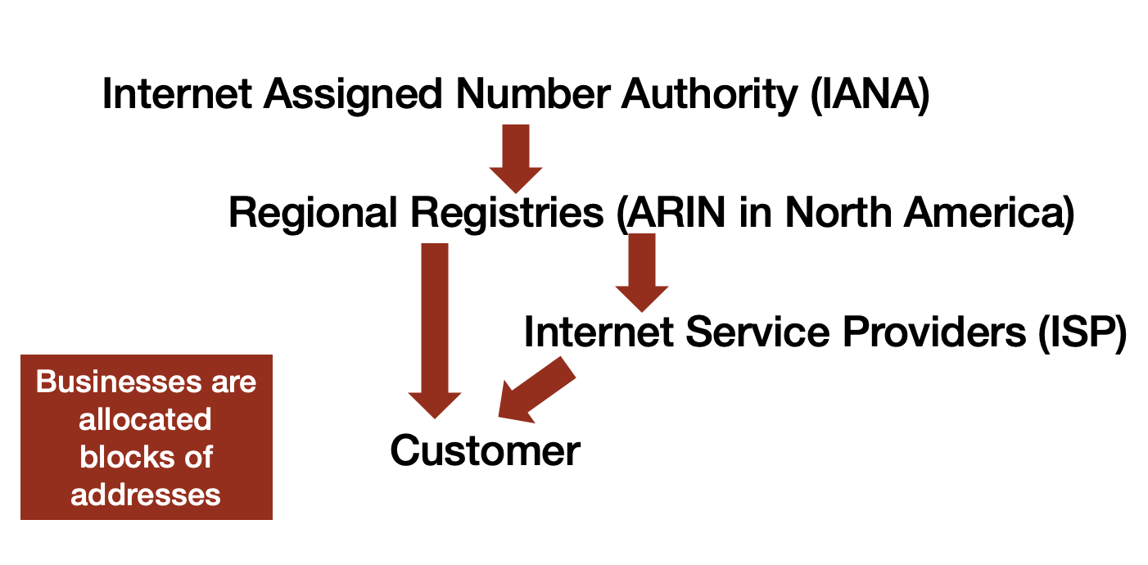
IP Address Allocation
Public addresses are managed by the Internet Assigned Number Authority (IANA)
Addresses allocated by geographic region
Regional Registries assign to Internet Service Providers (ISP) and large businesses
Private IP blocks allow businesses to allocate addresses internally without regard to the public addresses
Network Address Translation (NAT) at the edge converts from private addresses to public addresses

Slide 81
Private vs. Public IP Address
To overcome address exhaustion private address are used
10.0.0.0 /8
172.16.0.0 /12
192.168.0.0 /16
Private IP address not to be used on the Internet
Must use NAT/PAT to a public address obtained from ISP
blog.hill.com
66.228.126.195
Private
internet
10.1.1.1
NAT
192.168.1.1
192.168.1.2
200.1.1.1

Slide 82





IP Address Assignment Example
Network 1
dynamic
Network 3
dynamic
192.168.20.0/24
DHCP
static
Access Point
DHCP
static
static
static
192.168.0.0/24
NAT
Network 2
DHCP
static
static
Public
Rest of the World
192.168.10.0/24
dynamic

Slide 83

IP Addressing Concerns
Explosive growth of the internet created serious concerns about the depletion of the IP address space
In the 1990s several initiatives were taken to ensure we would not run out of addresses
Classless inter-domain routing (CIDR)
Network address translation
Greater use of private IP address space
IPv6
Today exhaustion of IPv4 address space is
almost here at the Regional Registries

Slide 84
Crisis, What Crisis?
IPv4 address exhaustion at IANA occurred in February 2011
Large IP address blocks are no longer available for allocation from the major registries
IP addresses can now be traded
We can get more aggressive address reclamation using NAT
What happens when no more IPv4 addresses are available?

Slide 85

IPv6: What Is It?
The next generation of IP motivated by the anticipated exhaustions of IP addresses
Developed in the 1990s
New packet header structure (not very backwards- compatible with IPv4)
Expanded address range, 128 bits!
Improved security
Flow definition
Auto configuration built in
Anycast
Significant effort required to migrate

Slide 86
When Is IPv6 Coming?
It has been around since mid 1990s
Adoption is slow in some areas
More rapid in others
Areas of the globe with limited IPv4 addresses for their needs
Mobile phones
Single purpose devices needing lots of IP addresses (cable boxes)
All major internet connected devices support both IPv4 and IPv6
Overtime more traffic will move over to IPv6

Slide 87
Routing and Forwarding
These are what routers do to make the internet work.
Forwarding packets from the source to the destination.
Building tables of destination networks and the neighbors who can get them one “hop” closer to them. This is called Routing.
Forwarding based on the routing table
Forwarding decision is local
The routing table is maintained by the routing protocol
Routing protocol uses non-local data to build the table
Router can contain rules that determine behavior

Slide 88
IP Routing
The forwarding of IP packets to the destination
End-to-end path is not predetermined
Hop-by-hop routing
Router selects next router based on destination address
Often described as best-effort service
Net
Address
Next Hop
Network A
.
Network A
Network B
.
.
Router 1
Router 2
.
Router 1
To Network A
To Network A
Network B
Router 2

Slide 89


Following a Packet
Net
Address
Next
Hop
TRL
Packet
HDR
Packet
.
Network A
Network B
.
.
Router 1
Router 2
.
HDR
Packet
TRL
Packet
Packet

Slide 90
Where Next?
Customers
WFH
Service
Providers
internet
Branches
Private
Network
HQ/datacenter

Slide 91
Connecting to the WAN

Slide 92
Bank Branch Connection
Branches need to access applications
Internal applications at the datacenter
Core applications at a service provider
Cloud applications at a cloud datacenter
Common network architecture uses private network connection to the internal datacenter for all traffic
We have a variety of options for the connection
Private Line
MPLS
Carrier Ethernet
VPN

Slide 93
Private Lines
Dedicated physical connection or bandwidth between sites or as access to carrier service
Old school technology, such as T1, were originally designed for the public voice network
Most private connections today are optical fiber Ethernet connections to other services
MPLS
Carrier Ethernet
Carriers are investing heavily in expanding their fiber footprint
Private wireless networks are an option in come cases

Slide 94
Ethernet Access
Ethernet has expanded from the LAN to the WAN
Optical fiber is the medium of choice
Dedicated fibers frequently used for business services
MPLS
Carrier Ethernet
Internet access
Shared access offers lower cost option based on Passive Optical Networking (PON) technology
Originally used for home services
Cost effective approach for business internet access

Slide 95
Dedicated Access
Speeds up to 100 Gbps available
Strong SLAs
Dedicated Fiber Pair
Fiber
Termination
WAN Service Provider

Slide 96
Shared Access
Speeds up to 1 Gbps available
Fiber
Termination
Single Fiber
Fiber
Termination
Fiber
Distribution
internet Service Provider
Up to 32
splits
Fiber
Termination

Slide 97
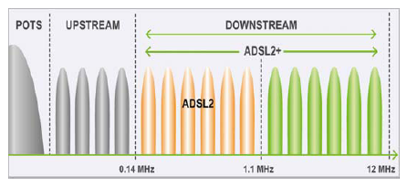
Digital Subscriber Line
Internet access using telephone lines
Digital Subscriber Line (DSL)
Umbrella for a variety of technologies using phone line
Speeds vary with distance (loop length)
Typical maximum speeds are 100 Mbps down and 20 Mbps up
Maximum distance is ~12,000 ft
Often service of last resort especially in rural areas

Slide 98
Cable Modem
Cable company data infrastructure
Hybrid Fiber Coax (HFC)
Fiber from cable company headend to a node (near customer)
Coaxial cable from node to customers (shared access)
DOCSIS protocols control access and transmission format
Service speeds available vary based on technology deployed
Asymmetric speeds often 1.2 Gbps down and 35 Mbps up
Multi-gigabit symmetric services starting to be deployed
Cable
Modem
Node
CMTS
internet
Coax
Fiber Pair

Slide 99
Let me ask you…
What is your broadband connection?
If you have options, why made you make this choice?

Slide 100
Private WANS

Slide 101
MultiProtocol Label Switching
MPLS provides a private IP network between sites
Introduced in the late 1990s it became the predominant private networking solution
It does not use the internet
Connections to the MPLS service use a variety of private lines
Available everywhere
Carrier Ethernet started to displace MPLS in mid-00’s for higher speed applications
Recently SD WAN has started to become the service of choice for branch networks

Slide 102





Class of Service
Applications have differing performance requirements
Class of service can be used to prioritize applications with sensitive need
Destination x
Priority normal
Sorter
Destination x
Priority high

Slide 103
MPLS
MPLS edge functions as a router in the private network
Packets forwarded through the MPLS network to the appropriate edge router
Inherently secure
Provides ability to prioritize packets
Rapid reconfigurations in case of link failure
MPLS
HQ/datacenter

Slide 104
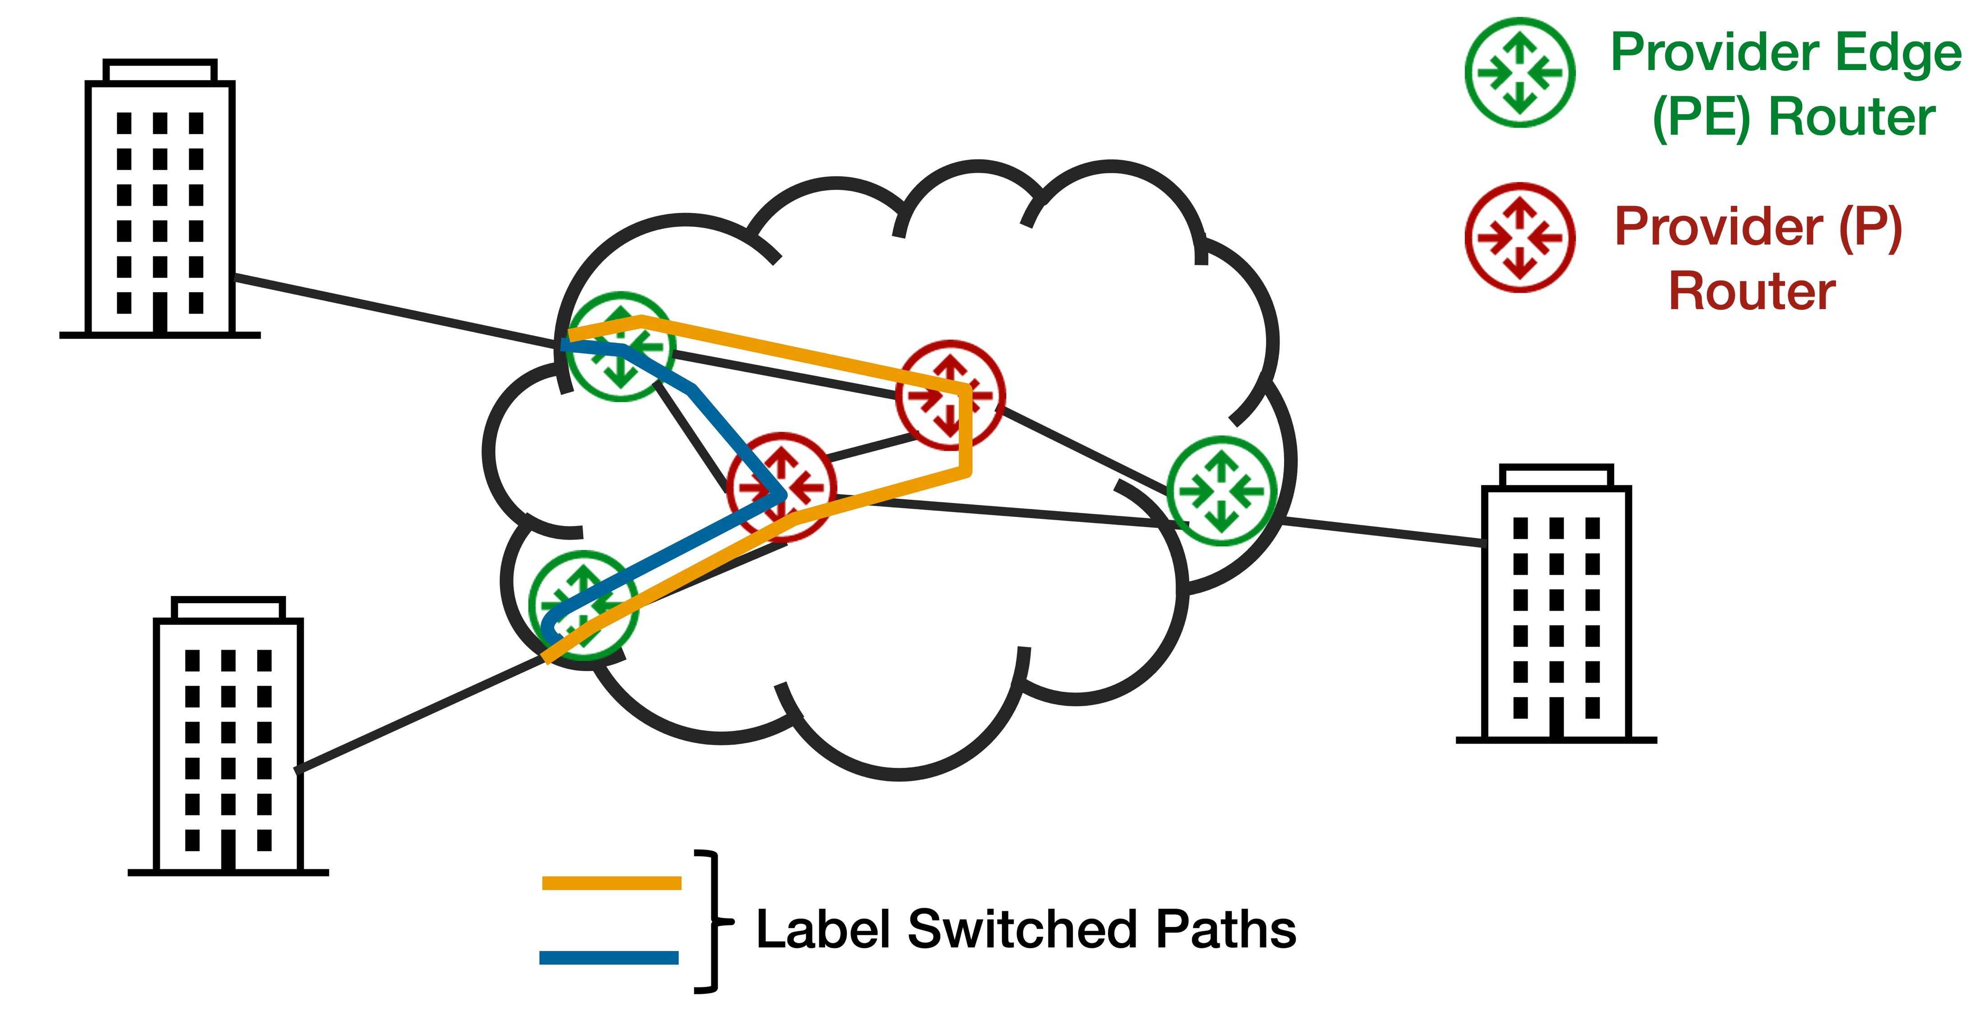
MPLS Operation

Slide 105

Carrier Ethernet
Carrier networks have become fiber rich
Growth of fiber in metro areas enabled widespread access to services using Ethernet
Led to industry development of Carrier Ethernet service specifications through the Metropolitan Ethernet Forum (MEF)
Certification of carriers, equipment and professionals has helped interoperability and grown the market
Very popular in metro areas where fiber is widely available

Slide 106
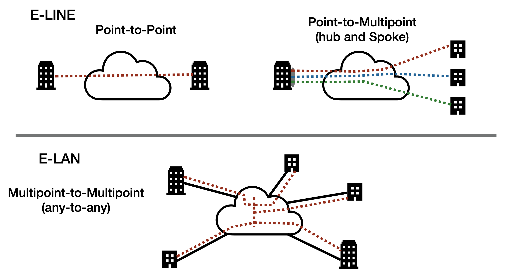
Carrier Ethernet Connectivity Models

Slide 107
Use Cases
Point-to-Point
Data replication between datacenters
Connection to partner
Service provider
Cloud services
Internet access
Point-to-Multipoint
Secure connection to customers
Hospital to specialty providers or another hospital system
School district connections from schools to datacenter
Any-to-Any
General connectivity between sites
WAN functions like a big LAN switch
Customers usually put routers on the edge of their network

Slide 108
The Internet

Slide 109
Let me ask you…
How has the internet changed banking?

Slide 110
The Internet
From bulletin boards to…
Businesses use the internet in many ways
Provide product information to customers
As a sales platform
Deliver product support
Communicate with partners
Access applications
Collect and sell user data
Research
What else?

Slide 111
The Internet: A Global, Public, Packet Network
Service
Providers
Internet
Service
Providers
ISP
ISP
ISP
ISP
ISP
ISP
ISP
ISP
ISP
ISP

Slide 112
Connecting to the Internet
A wide variety of access options already discussed
DSL
Cable Modem
Ethernet
Wireless options have increasingly grown in access share
Mobile phones
Fixed wireless access
Mobile
Wi-Fi
Satellite

Slide 113
Cellular (Mobile) Networks
Many similarities to Wi-Fi
Specific bands allocated for the service
Multiple generations of the technology with each improving performance
Bands vary by country
Current generations have added new bands to increase capacity
Frequency (channel in Wi-Fi) reuse provides coverage in a wide area
Some differences
Original application was voice, data added over time
Handoff between cells creates WAN
Protocols to interconnect carrier networks part of the standards
Spectrum requires a license

Slide 114
Cellular Network Evolution
Analog to digital
Voice to data
Single frequency band to multiple bands (varies by country)
Multiple technology standards globally to one
Increased use of fixed wireless access (FWA) for residential and business internet access
Move to edge computing to support low latency applications (industrial controls and self-driving cars being examples)

Slide 115
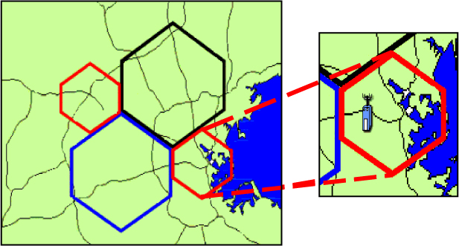
Cellular Concept
Frequency reuse between base stations
Base station to base station handoff
Base station connection to voice and internet at Mobile Switching Center

Slide 116
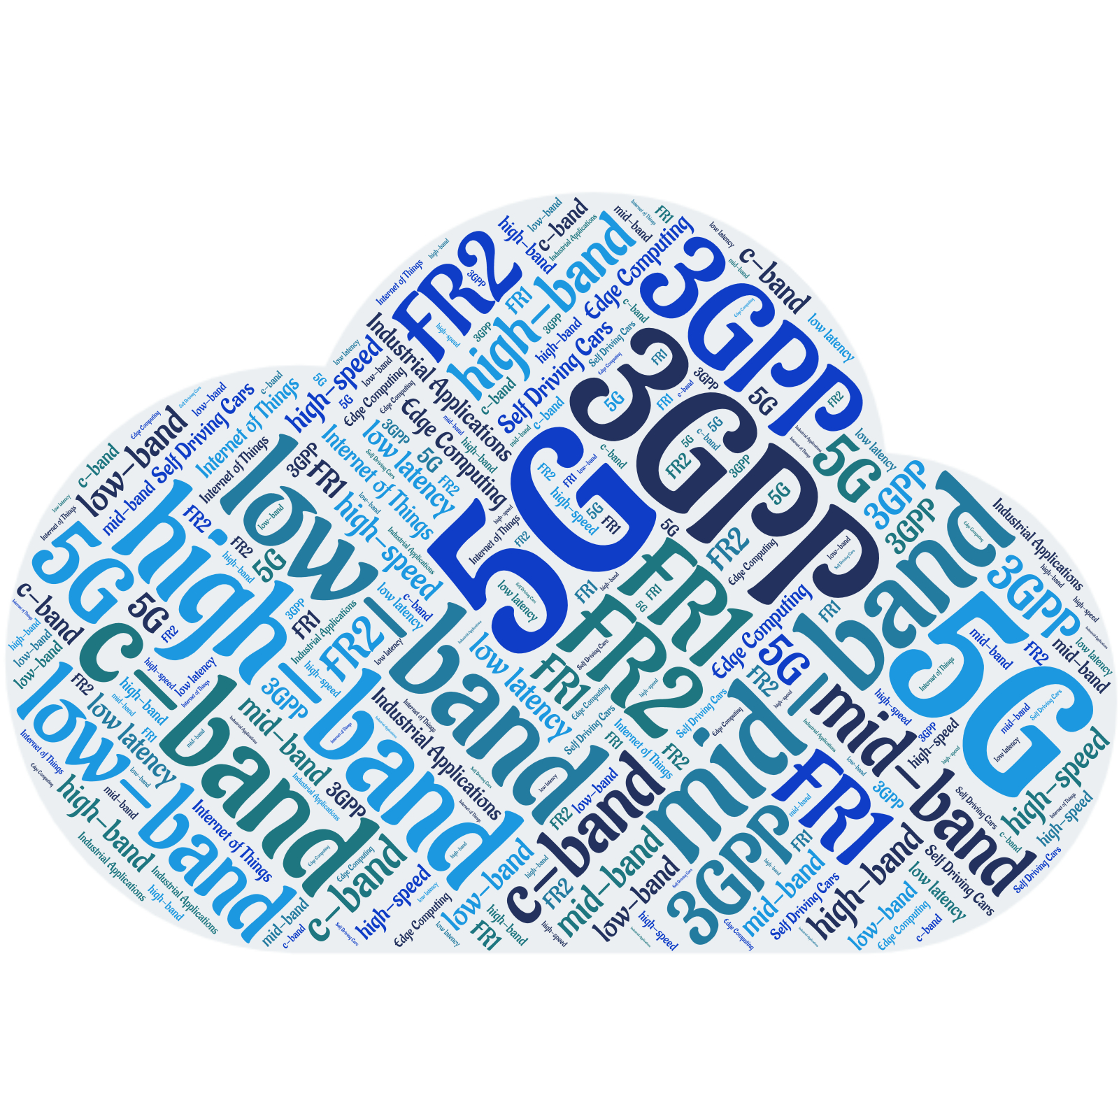
5G
The current generation of cellular wireless
Still in early stages of deployment
Lots of variations globally
Key changes from 4G
New modulation schemes
More frequency bands
Higher speeds
Lower latency
Fixed wireless options
Internet of Things (IoT) support

Slide 117
Back to the Bank
Customers
WFH
Service
Providers
internet
Branches
Private
Network
How can the bank
use the internet?
HQ/datacenter

Slide 118
Work From Home
VPN offers a secure connection to the bank, cloud and service providers
Encrypted tunnel to VPN server coupled with multifactor authentication
Where should the VPN server be?
On premises
In the cloud
Is there anything else we could do for the home network?
Separate SSID or Access Point
Corporate owned and managed home-based firewall

Slide 119
Site-to-Site VPN
Offers low-cost approach to building a WAN
Point-to-Point VPN configured at network edges
Branches
VPNs over
the internet
HQ/datacenter

Slide 120
VPN as a WAN Challenges
Historically a manual configuration in edge devices
Potential for errors
Unlikely to change keys frequently due to effort required
Limited visibility into performance
No control of applications

Slide 121

Software Defined WAN
SD WAN modernizes the approach to deploying a VPN WAN
PORTAL
Configuration management
Network visibility
Business continuity rules
Security policies
Branch #1
Control
Data
SD WAN
CPE
SD WAN
CPE
VPN
Branch #2
HQ
Datacenter
SD WAN
CPE

Slide 122
SD WAN
Central configuration and orchestration automates deployment
Greater visibility than traditional WAN solutions
Application-level routing and management
Simple deployment of BCP rules
Often sold as a managed or co-managed solution
Security at the branch level or in the cloud
Secure cloud connectivity
Various implementation models

Slide 123
Sample SD WAN Implementation
Performance
Data Gathering
BCP Rules
ISP 1
Application Routing
VPN
Security
internet
ISP 2

Slide 124

Observations for SD WAN Branch Networks
Benefits
Simpler configuration and implementation
Connectivity
Security
Business continuity
Greater visibility
Overall performance
Application specifics
Lower cost
Cloud integration

Slide 125
Connecting to Servers and Applications

Slide 126
Transport Layer Connections
Connects client to server
Internet Protocol Suite offers two options
Transmission Control Protocol (TCP)
User Datagram Protocol (UDP)
Transport Protocols
Client
Server
Network

Slide 127
Other Transport Layer Functions
Connectionless and connection-oriented operation
Error detection
Bit errors
Packet loss
Out-of-sequence delivery
Error correction
Bit errors
Packet loss
Out-of-sequence delivery
Application addressing
Flow control
Enhanced capabilities
Security
Timing

Slide 128
Two Options
TCP
UDP
End-to-end application connection
Establish connection
Manage connection
Guaranteed delivery and sequence of data
Application addressing
Connectionless (datagram) communications
Error detection at receiver
Application addressing

Slide 129
Connectionless Communication
Stuff
Data Transfer

Slide 130
Connection-Oriented Communication
Can we talk?
Connection Establishment
Sure!
Stuff
Data Transfer
Got it!
I’m Done
Connection Release
K thx bye!

Slide 131
Let me ask you…
What are connectionless and connection-oriented protocols good for? Do we need both kinds?

Slide 132
Error Detection and Correction
Bit errors
Packet loss
Out-of-sequence delivery

Slide 133

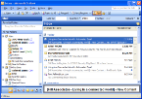
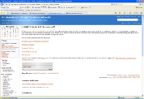
Application Addressing
…or here
Layer 3 address gets us here
Layer 4 address gets us here…

Slide 134
Servers and Listening Ports
Requests for multiple services to a single server
Each request initiates a transport session
The server listens for a request on a specific port to know which application to activate
SMTP Request
HTTP Request
Passive Listening
on Multiple Ports
FTP Request

Slide 135
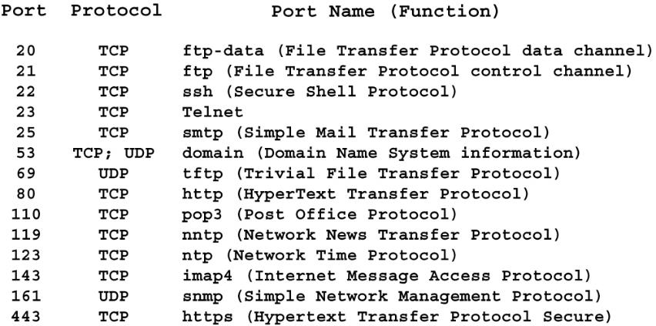
Well-Known TCP/UDP Ports
Port identifies higher layer protocol

Slide 136


Enhanced Functionality
Security
Typically associated with TCP
Protocol can implement an encryption capability
Protocol can implement an authentication capability
Transport Layer Security (TLS)
Timing
Typically associated with UDP
Critical for applications containing time-sensitive information
Voice applications
Video applications
Real-Time Transport Protocol (RTP)

Slide 137
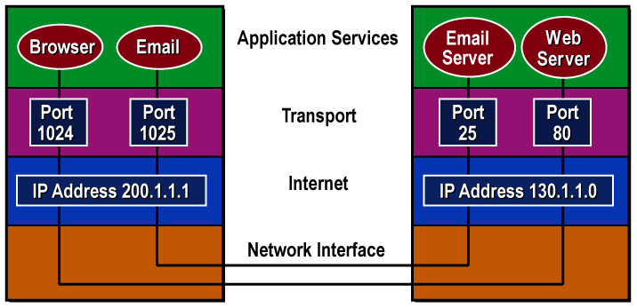
Sockets
130.1.1.0:80 refers to the Web server at this IP address
Socket = IP address + port number

Slide 138
Transport Layer Security
Provides secure encrypted connection between client and server
Replaced Secure Socket Layer (SSL) although the terminology of SSL continues to be used
Part of HTTPS (port 443) for secure web traffic
Combines authentication and encryption
Current version 1.3
Some systems may still use v1.2

Slide 139
Cryptography
The science of writing in secret codes
Dates back to 1900 BC in Egypt (nonstandard hieroglyphics); probably appeared spontaneously soon after writing was developed
Necessary in telecommunications when communicating over any untrusted medium or storing sensitive information
Three types
Hash functions
Secret key
Public key

Slide 140

Hash Functions
No key
Plaintext is not recoverable from the ciphertext
Examples: MD2, MD4, MD5, SHA-1, SHA-256
Also called message digests or one-way encryption
Primary uses: digital signatures and password storage

Slide 141

Secret Key Cryptography
Single key
Same key is used for encryption and decryption
Examples: DES, Triple-DES, IDEA, RC4, RC5, AES
Also called symmetric cryptography
Primary use: Privacy

Slide 142
Advanced Encryption Standard (AES)
Symmetric key cypher with key sizes of 128, 192, and 256 bits
Block substitution-permutation cypher based on 128-bit block
Number of cycles based on key size
Each cycle performs multiple block substitutions, permutations, and mixing to encrypt the data
ation of the algorithm

Slide 143

Public Key Cryptography
Two keys based on the prime factors of a large number
One key is used for encryption and the other for decryption
Examples: RSA, Diffie-Hellman
Also called asymmetric cryptography
VPN functions
Identity verification
Secret key exchange

Slide 144
RSA
Diffie-Hellman started the path to public key cryptography
RSA was the first approach to public key systems
Developed at MIT in 1977
Based on creating a public key from the product of two large prime numbers
Key length today is 2048 bits
Used in certificates
Being replaced by Elliptic-curve cryptography using 256-bit keys

Slide 145
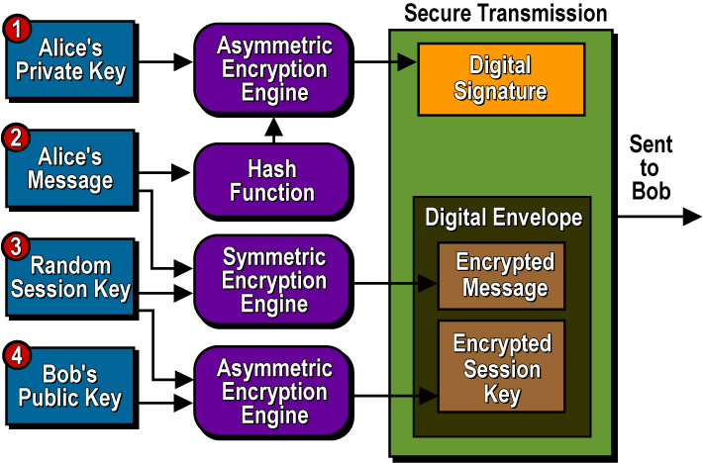
Sample Application: Email

Slide 146
Final Comments on Cryptography
Cryptography alone cannot guarantee 100% security
But we can achieve a high level of risk acceptance where benefits outweigh the losses
The goal is to balance the possible with the acceptable
Strong cryptographic systems can withstand attacks up to a point
The mathematics is rarely the weak link!
Must consider the threat, system design, implementation, users, and legal/political environment

Slide 147
Real-Time Transport Protocol (RTP)
A connection-oriented service building on UDP
Connections are negotiated by other protocols (e.g., RTCP or SIP)
Adds several functions to UDP
Sequencing
Packet dependency
Delay
Jitter
Commonly used for
Voice over IP (VoIP)
IP telephony (IPT)
IP television (IPTV)
Any audio/video application

Slide 148


Port Address Translation
Transport Layer header information allows multiple internal hosts to share the same public IP address
PAT works closely with NAT
200.1.1.1:5478
192.168.1.20:5478
200.1.1.1:6748
192.168.1.30:5478

Slide 149
Application Services

Slide 150




It’s All About The Applications
Applications perform tasks to deliver services to users
Communications is the act of users interacting with software performing the desired function
Application services define the protocols for communication and services supporting communication
Two models exist
Client-server
Peer-to-peer

Slide 151

Application Layer Concerns
Information syntax
Information semantics
What the information means
What information elements are required
How the information elements are exchanged
Applications types
User applications
Network support facilities
Resource sharing utilities
Network management packages

Slide 152



Clients and Servers
I’ve got something that system wants…
That system’s got something I need…
Network
Client
Server
Desktops
Laptops
Tablets
Cell phones

Slide 153
Service Relationship: Client/Server
Applications have clearly defined roles
Client initiates request
Server responds to client’s request
Server software is passive but available
Connects to local Transport Layer and waits for connection requests
Client transient in nature
Application is enabled on-demand
Connection to local Transport Layer is made/broken as needed
Examples
HyperText Transfer Protocol (HTTP)
Simple Mail Transfer Protocol (SMTP)
Application
Protocols
Client
Server
Network

Slide 154
Service Relationship: Structured Peer-to-Peer
Unstructured peer-to-peer is difficult to coordinate
How do you find the peers?
Many support the concept of seeds or “super peers”
Structured peer-to-peer combines client/server with unstructured peer-to-peer model
Servers used for search, discovery, coordination
Peers used to do the actual work
Examples
BitTorrent
Instant messaging (IM)

Slide 155
Let me ask you…
What application communications model is used in banking?

Slide 156
How Do We find Applications?
The Domain Name System (DNS) provides a distributed directory of internet resources
Essentially the directory assistance of the internet
Converts uniform resource locators (URLs) to IP addresses
Registries are databases that contain the domain names under the top-level domains they administer
Registrars are accredited companies that delegate domain names to interested parties

Slide 157


Domain Name System Exposed
Great now I can contact them
I would like to get Outside.com
We know who to ask
Who can I ask?
TLD DNS Servers
What is Outside.com’s
IP address?
Ask the DNS server at this IP address
What is Outside.com’s IP address?
Local DNS
Answer
Range of information in DNS Databases
A records
PTR records
MX records
CNAME records
TXT records
I know MyCompany.com
Answer
Other Local DNS
We know OtherCompanies.com, etc.

Slide 158
Email Services
Your_Name@aDomain.TLD

Slide 159
Let me ask you…
Is Google Gmail an email service, a WWW service or something else?

Slide 160


Simple Mail Transfer Protocol
POP3, IMAP
SMTP
SMTP
Sending Client
Sender’s Server
Recipient’s Server
Intended Recipient
Client/server model
Simple, text-based command language
Identify sender and receiver(s), transmit message, and provide confirmation
Developed to transport simple text notes only
Extended using MIME to include attachments
Requires retrieval protocols
Post Office Protocol v3 (POP3)
Internet Message Access Protocol (IMAP)
HyperText Transfer Protocol (HTTP) for web-based access

Slide 161
Summary
Data communications is described using a mix of models
Breaking functions into manageable chunks simplifies understanding
Functions are implemented in a combination of areas
Hardware
Operating systems software
Application software
New applications frequently reuse existing code which can add existing, but often unknown, vulnerabilities in the new application
Security has moved from an add-on to a build-in necessity

Slide 162
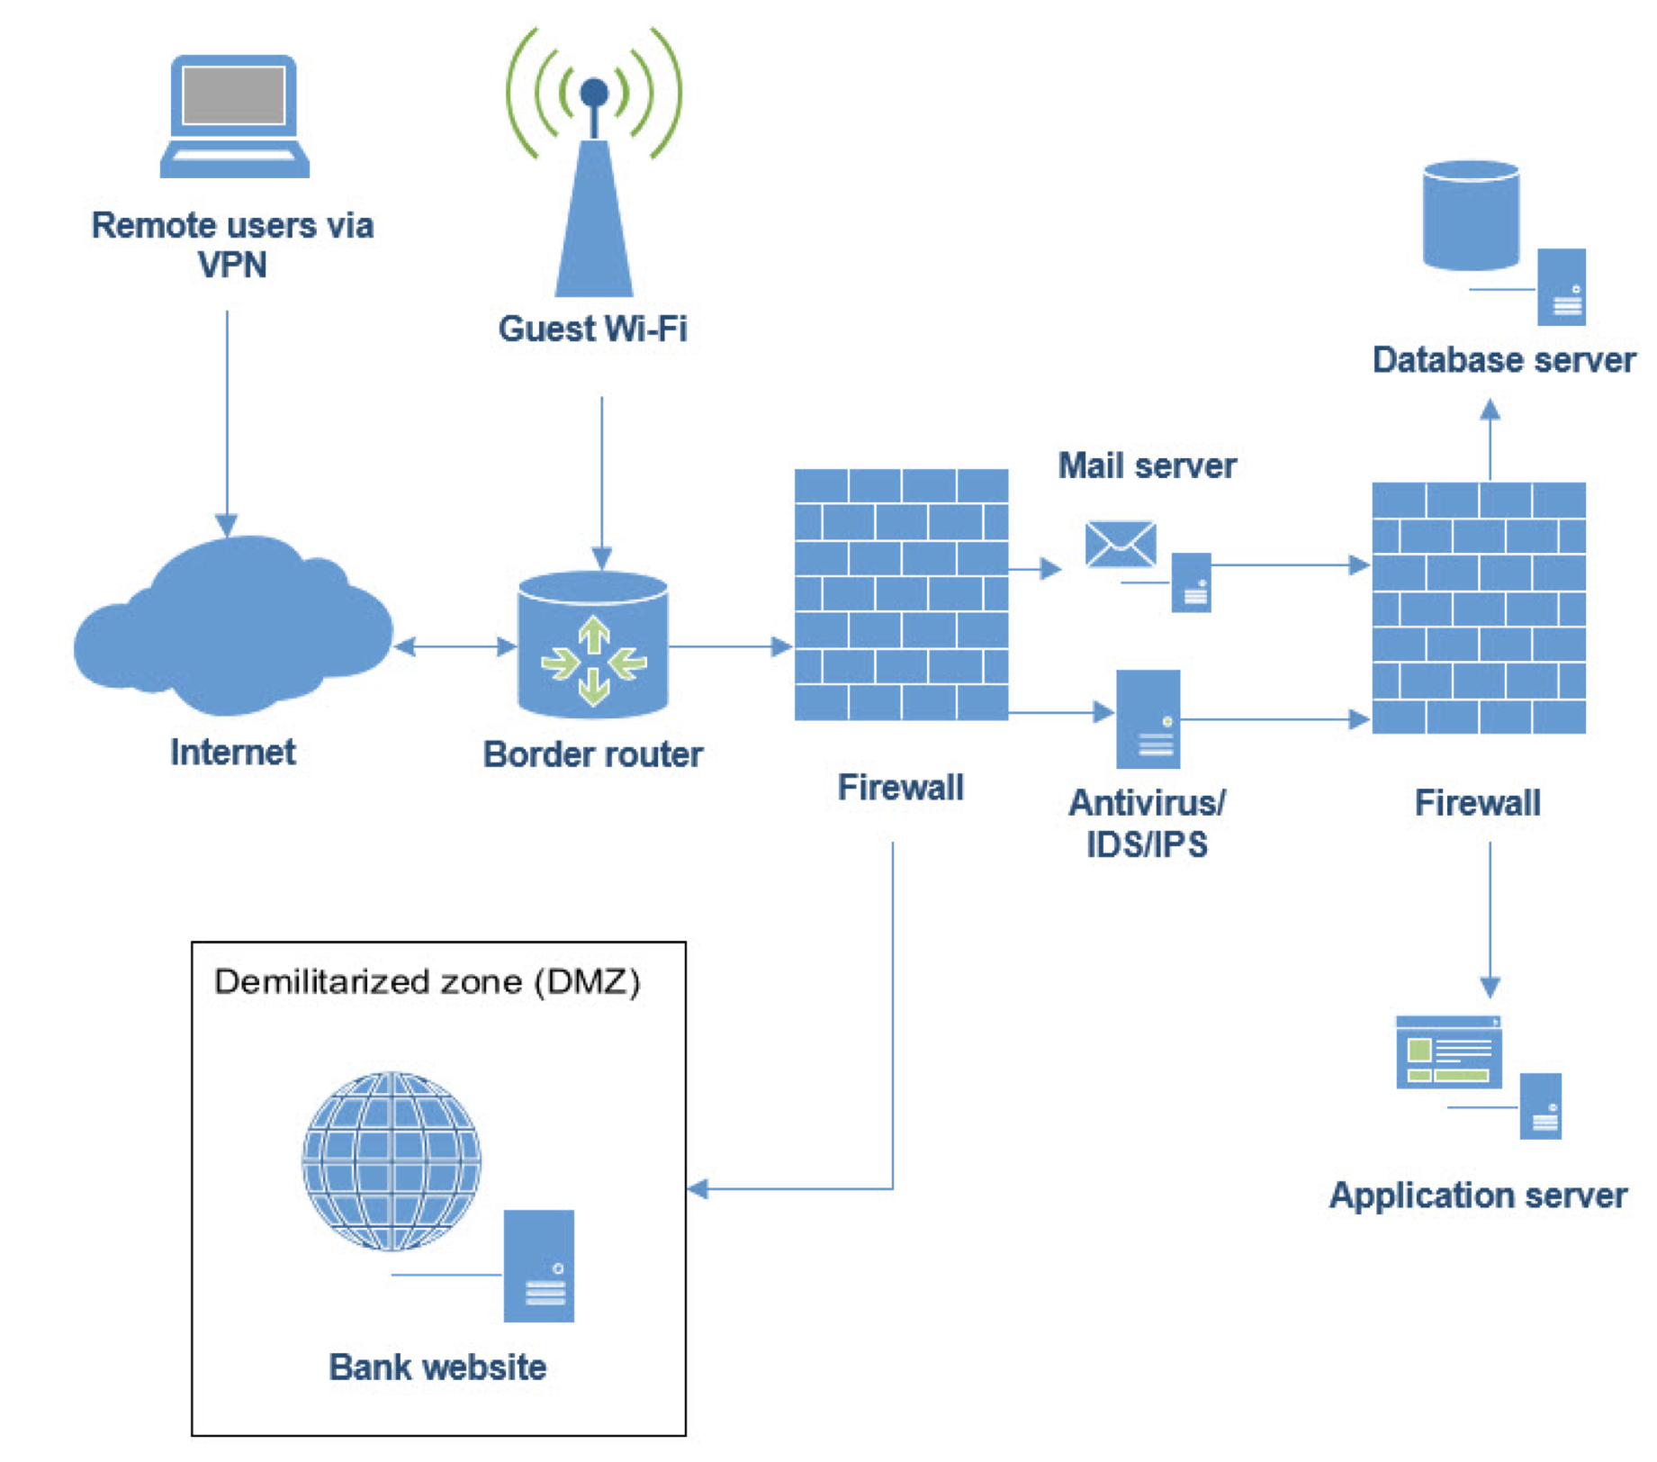
Network Diagram Review
Review attendee provided network diagram or use previously shared network diagram

Slide 163
Voice Networks

Slide 164
Thoughts on Telephony
It changed the world
Ability to talk in real time over long distances changed society
News could be learned in real time
Commerce could be conducted quickly
Relationships made and maintained
Spurred technology innovation
AT&T Bell Labs was a global leader in invention and development
AT&T competition was equally inventive
Was the home of tech giants in its heyday
Telephone networks were used to connect computers
Now relegated to being an application in a world of data

Slide 165
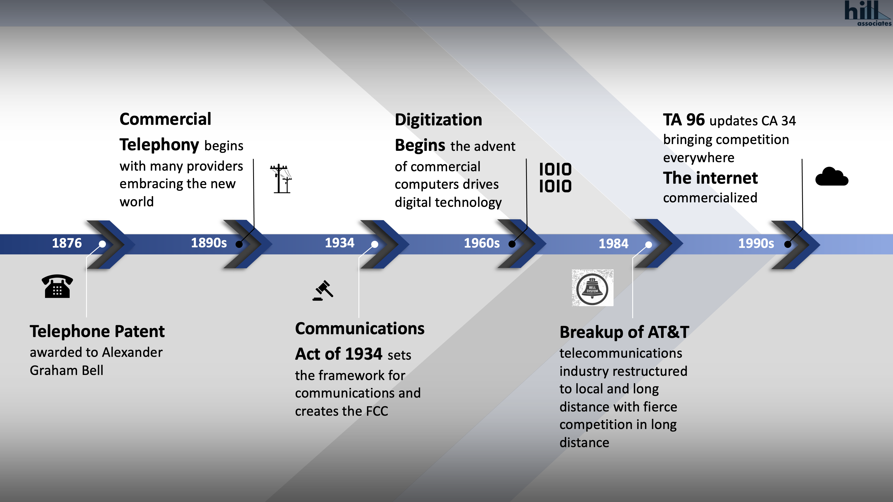

Slide 166
Telephone Network Elements
Trunk

Slide 168
North American Numbering Plan
10-digit structure of telephone numbers in North America
Three components
Numbering Plan Area (NPA) or area code
Uses NXX numbering structure (675 useable codes)
Assigned on geographic basis
Do not cross LATA boundaries
Exchange or central office (CO) code
Uses NXX numbering structure (792 usable codes)
Assigned to central offices/exchanges
Line number
Identifies particular line/station attached to a particular switch
802
655
0940

Slide 169
Private Branch Exchange
PBX places telephone switch on business site
CapEx reduces OpEx
Phones connect to switch using premises wiring
Switch connects to the PSTN using a trunk
Offered lots of features
Very popular 1980s to early 2000s
Many business have migrated to hosted solutions

Slide 170
Voice moves to IP
The 1990s saw the commercialization of the internet
As the internet took off, millions of users were looking for things to do in this new world
Innovation drove significant advances in technology of networking, computing and applications
As corporate networks moved to IP technology, so did the world of telephony
Voice over IP (VoIP) has almost completely replaced the old phones and switching systems
VoIP may, or may not, use the internet for connection and transport

Slide 171
VoIP Brings New Capabilities
Greater call control capabilities managed via a portal
Allows simple call forwarding to other devices (phones, apps)
One number, many devices, anywhere
Mobile phone apps allow calling from the office number within the app
Rich in traditional telephony features, simpler to use
Integration with conferencing capabilities (video, chat/IM, etc.)
Improved business continuity options

Slide 172
Let me ask you…
How many of you have landlines?
What percentage of business calls do you do via Teams (or equivalent)?
How do banks use desk phones?

Slide 173



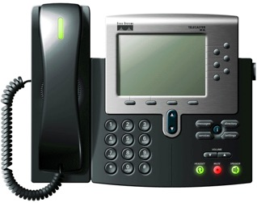
IP Phone Options
Voice
Gateway
Conventional Telephone
Softphone
IP Packet Network
IP Phone

Slide 174
Signaling Control: The Role of SIP
Signaling protocol for multimedia sessions
Dominant IPT signaling protocol
Signaling Control
IP Phone
SIP

Slide 175
SIP Trunks
An IP telephony (IPT) trunk
Designed for use with an IP PBX
Typically shares voice and data
Burst data when voice not in use
Maximum concurrent calls configured
Call signaling over the trunk is SIP
Carrier Voice Services
IP Network
SIP Trunk
Private Corporate IP Network

Slide 176
Hosted VoIP
Back to the old model of the intelligence (switch) being in a provider’s network
Offers many business continuity capabilities
Generally lower cost than premises solution for small and medium sized businesses
Like old systems most features are lightly used
Solutions may use the internet for access or private (trunk) connection

Slide 177
VoIP Network Considerations
Does the VoIP traffic share a LAN with data?
How is voice quality ensured?
What type of connection is used to connect to the PSTN?
If this connection goes down, what happens to the ability to make and receive calls?
Do employees have portal access to manage their phone service? If so, what access controls are in place for them?
What bank functions may be impaired by the loss of telephone services?

Slide 178
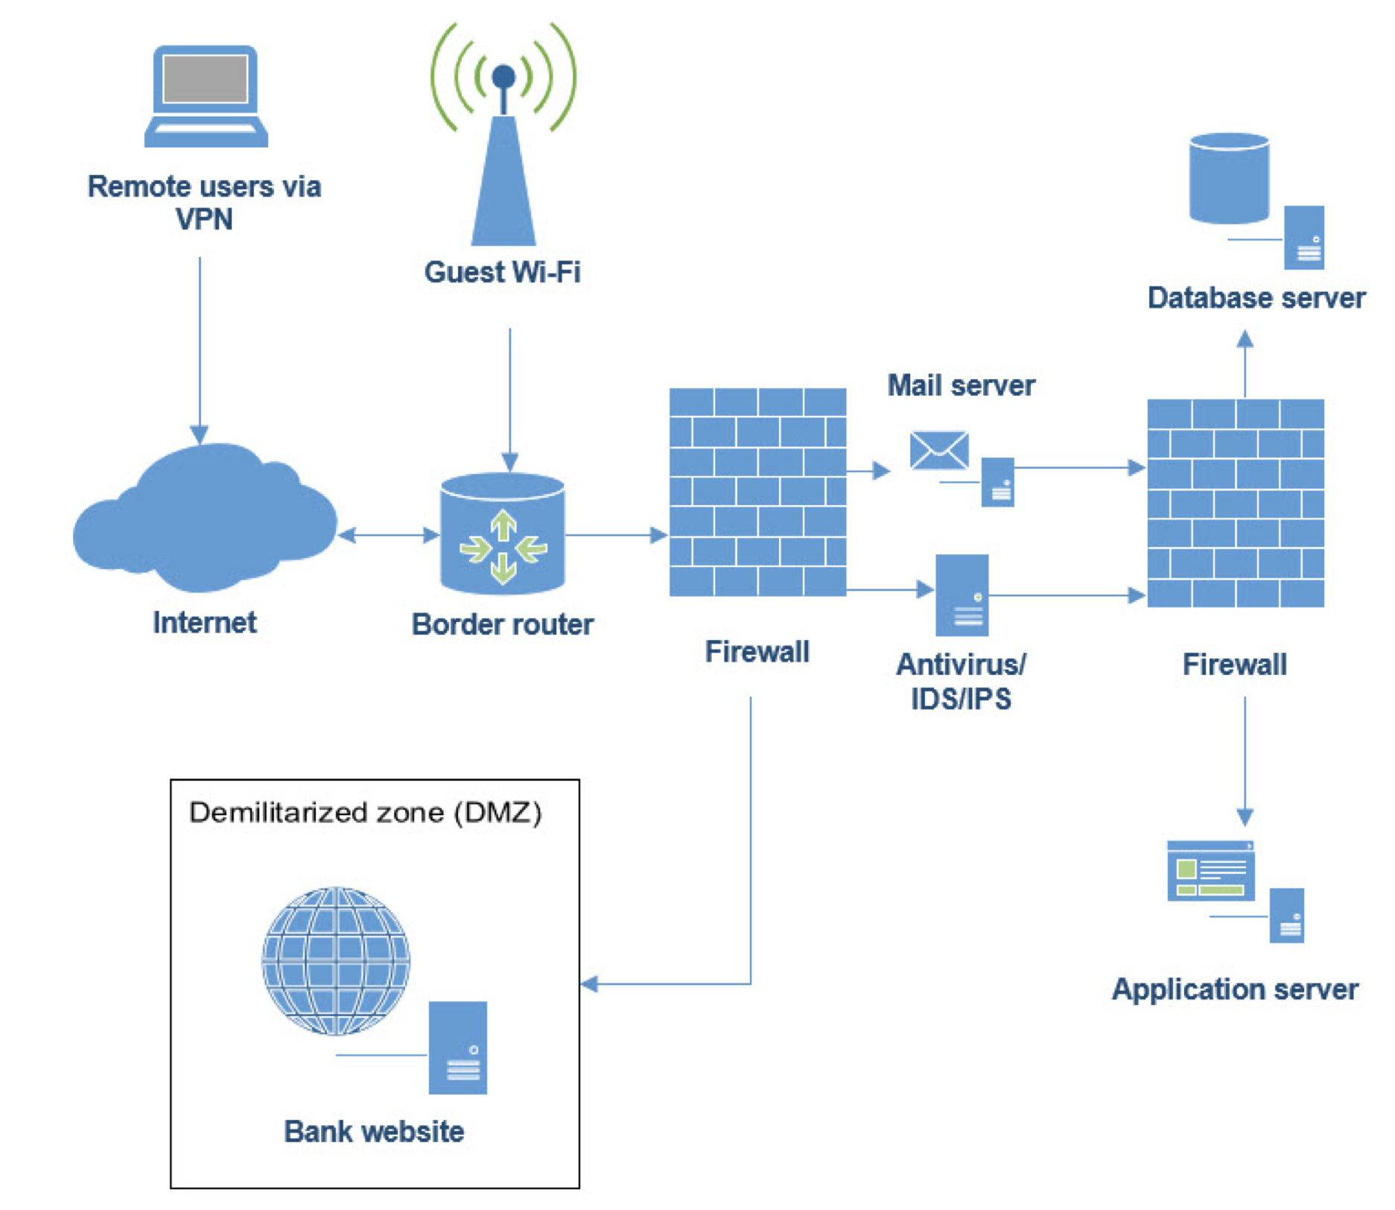
Voice System Review
Review attendee provided telephone
network diagram

Slide 179
Network Security

Slide 180
Networks
Customers
WFH
Service
Providers
internet
Branches
Where are the threats to security in this diagram?
What questions do we need to ask?
Private
Network
HQ/datacenter

Slide 181
Network Security
It starts with taking inventory
End user systems
Servers
Network elements
Networks
Followed by risk analysis
Activities and tools designed to protect the usability, reliability, integrity of a network and corporate data housed within.

Slide 182
Inventory
If we don’t know we have it, we can’t protect it
End user systems and servers contain networking elements that need to be kept current (patched)
Many systems are now being networked and are classified as part of the Internet of Things (IoT)
Networking elements and networks need to be protected and require attention beyond those supporting end user systems
Technology refresh needs to be part of the plan

Slide 183
Internet of Things: Some Sample Things
Automation
Communication
Monitoring
Transportation
Management
Intelligence?

Slide 184
IoT Security Concerns
Estimates for IoT suggest 20 billion devices will be connect via the internet in the next 10 years
What emphasis will be placed by developers on security?
Will consumers and businesses implement controls?

Slide 185
IoT Things to Consider
What mechanism is used to track the devices?
How are updates made to the device?
Can the device be checked by the vulnerability scanner?
What data is collected by the device and where is it stored?
What software is on the device? Can it be hardened?
How are the devices configured and managed? Can access be recorded in the log system?
What connectivity options are there for the device? How are they managed?

Slide 186
Ethernet Considerations
Switch location and access
Administrative access control
Limit who has access
Log access and changes
Closely manage remote access
Firmware and management software patching
Rogue device identification
VLAN design, management, interconnectivity
Encryption

Slide 187

Wi-Fi Considerations
Access Points should be commercial grade
Firmware upgrade
Control access to resources through the creation of separate networks (SSIDs) based on need
Use strong passwords
Change policy
Rogue devices
Management access controls
Implement time profiles to stop after hour access
Mesh management

Slide 188
WAN Considerations
Management access controls and logging
Provider and customer roles
Access
Business continuity
Private
SLAs
Encryption
Zone implementation
Internet
Perimeter protection (firewall, IDS/IPS…)
VPN management
Certificates, AAA...
Licenses
Private Line
Ethernet
MPLS
internet

Slide 189
Voice Security Considerations
Management access and controls
Patching
Separate LAN zone
Encryption
On premises or hosted
Connection to provider
Private
Internet
Business continuity

Slide 190
Many Sources for Baseline Security Measures
NIST Cybersecurity Framework
Council on Cybersecurity Critical Security Controls
ISO 27001/2
International Information Systems Security Certification Consortium (ISC²)
Vendor whitepapers and case studies

Slide 191

Is Big Brother the problem?

Slide 192
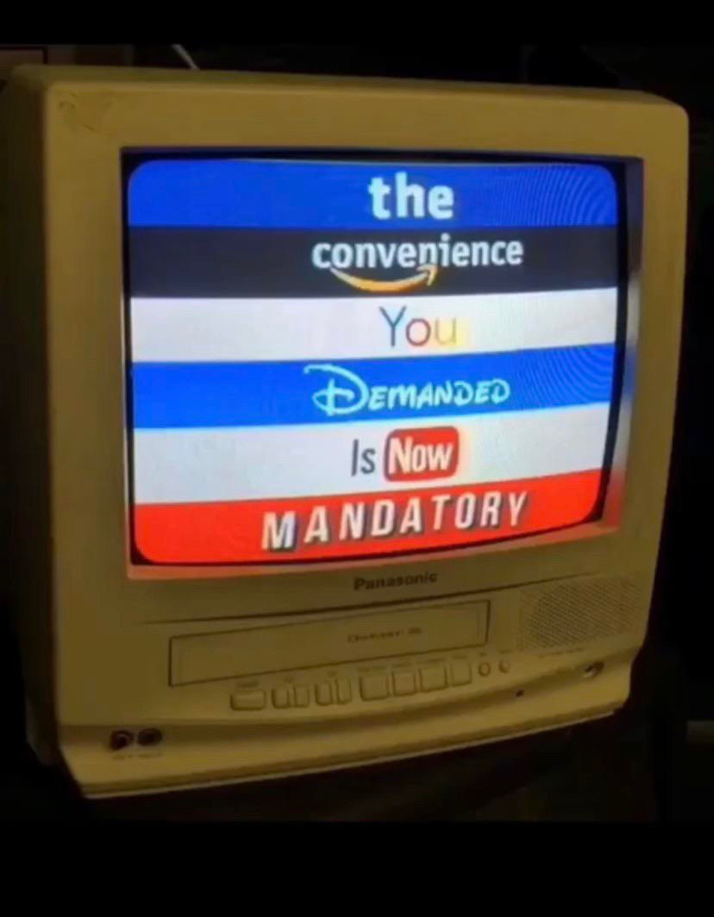



Privacy

Slide 193
Service Provider Security Solutions

Slide 194

Managed Security Solutions
Security has become a critical infrastructure issue
Threats growing more complex and sophisticated
Skilled security personnel shortages drive outsourcing
Outsourcing some or all of security a growing industry
Usually called Managed Security Service Providers

Slide 195
Many Players
Network equipment manufacturers
Moved to offer security in their offerings
Security capabilities include subscription for capabilities and ongoing monitoring, updates and management portal access
Security software and equipment providers
Historically limited focused offerings
Many expanded service set or have been acquired
Broader range of security offerings (e.g. perimeter security added endpoint)
With AI and ML, monitoring has become integral to the product
Expansion into network space
Professional services (design and incident response)

Slide 196
Some More Players
Computer manufacturers
Extension of their professional services business
SOC services
Telecommunications service providers
Networks need protecting security often an integral part of the service
Expansion into professional services
Systems integrators
Natural expansion of their professional service offerings
Local IT providers
Financial service technology providers

Slide 197
Let’s take a look at a few MSSPs
Research an MSSP and see what they do, and how. Feel free to glance at them all, but you need only “report” on yours.
I’d like to know:
What did you think of this company’s pitch?
What surprised you about them? Anything particularly impressive?
Would you be happy to see them at a bank you examined?
No stress, you don’t need to make a slide deck! Just informal thoughts and impressions.
Group assignments:
Group 1: SBS Cybersecurity https://sbscyber.com/
Group 2: Arraya Solutions https://www.arrayasolutions.com/
Group 3: SilverSky https://www.silversky.com/
Group 4: Optiv https://www.optiv.com/

Slide 198
Emerging Technologies

Slide 199

Software Eats the World
Marc Andreesen (Netscape, Andreesen Horowitz)
Every device, appliance or box in this course is going away or being consolidated with others
They are being replaced with software running on:
General purpose silicon (CPUs)
Graphics processors (GPUs)
Embedded Devices
Almost everything else (IoT, appliances, smart devices)
This trend is not confined to networking!

Slide 200
Virtualization
Virtualization started with the recognition that server power had increased significantly and most servers were underutilized
Servers often support a single application only
The 1960’s virtual machine concept came to the rescue
One server can now act as multiple virtual servers
Concept has expanded to storage and networks
Application
Operating
System
Hardware

Slide 201

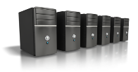

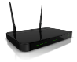
Virtual Machines Benefits
Application
Application
Application
Operating System
Operating System
Operating System
Virtual Machine
Virtual Machine
Virtual Machine
Virtual Infrastructure
Servers
Storage
Network
Network
Storage

Slide 202
Cloud Deployment Models
Cloud services come in four variants
Private – infrastructure deployed for a single entity
Community – provisioned for a community (e.g. government agencies)
Public – open to use by anyone
Hybrid – combination of two or more cloud infrastructures
Many organizations use cloud services for select applications
Multi-cloud is the norm
Migration ongoing for most organizations
Responsibilities depend on deployment and service model

Slide 203
Cloud Service Models
Colo
IaaS
PaaS
SaaS
Access Controls
Application
Application
OS
OS
Hypervisor
Hypervisor
Hardware
Hardware
Facility, power, rack, environment controls, fire control
Responsibility
Customer
Provider

Slide 204
A Step Beyond Virtualization
Clouds initially took existing applications and placed them on virtual servers
Each virtual server has its own full-blown operating system
Containerization looks at separate (isolated) application space
Operating System (OS)
Application
Multiple application containers may run in the same OS container (virtualized OS)
OS container may offer limited functions (lightweight) reducing processor load
Automated orchestration to manage cloud workloads (e.g. Kubernetes)

Slide 205
Traditional Application Approach
Application a single entity with multiple functions built-in
Developed using a single programming language
Large complex code set
Difficult to modify and redeploy
If one function is busy a whole new instance needs to be turned up to meet the demand
Monolithic
Application
User
Interface
Browse
Function
Shopping
Cart
Payment
User
Profile
Product
Database

Slide 206
Containers and Microservices
Cloud infrastructure offers offers a highly scalable environment for computing, storage and communication across multiple datacenters
Containers along with automated orchestration offer a flexible, scalable computing environment
Microservices implement functions independently in their own container
Microservices communicate with one another to deliver business services
User
Interface
Browse
Function
Shopping
Cart
Product
Database
User
Profile
Payment

Slide 207
Microservices
Independent processes
Processes connect via APIs and send data through a communications or messaging system
If one process is loaded a new instance of that microservice can be spun up
Benefits
Independent development (small teams, different languages...)
Easier to update
Scalable
Expandable
Many support tools to facilitate orchestration, communication, workload assignment, security, deploy updated services…

Slide 208
Not just Much Cheaper, the cloud is Much Better.
21st Century bank IT To-dos:
Build new data center.
Buy and deploy new servers.
Acquire offside DR location.
Reinvent the wheel. Again.
Take an application-focused approach.
Support innovation for the bank.
Access the same tools as the big guys.
Use data to remain competitive.
Lower expenses, owned>hybrid>public.
Improve and secure network access.
Performance, Business Continuity, and Disaster Recovery are all improved by a cloud approach.
Geographic diversity, fate-sharing, availability risk of all kinds is well-addressed in the hyperscale clouds.
Things better centralized, like compliance, become much easier with a single point of access.
The advantages are worth the risks (to most.)
Security is still a concern, but being addressed by advances in e.g. authentication and encryption.
More comprehensive, better correlated customer data can improve outcomes for banks and customers.
These benefits come with a new reliance on the network.
Which is why telecom and data communications are such important topics for banks and regulators.

Slide 209

The Changing IT Landscape
Businesses are undergoing a digital transformation
New applications increase knowledge and efficiency
Applications are migrating to the cloud
Networks need
Increased bandwidth
Simplified management
Greater visibility
These all improve in a cloud context!

Slide 210
Bank Network Topics

Slide 211




Core Processing in the Cloud
Historically, Core Processing was owned by a handful of specialized companies
Moving to the cloud poses both advantages and risks for core processors
Fintech solutions can rapidly add new capabilities and change what “core” means
Will the cloud come to the core before the core comes to the cloud?

Slide 212
Let me ask you…
What types of applications should banks move to the cloud first?
List some advantages and disadvantages of cloud services from a security perspective.

Slide 213
Network Talent and Trust as Risks
As network service become more powerful, they become more complex
Management software and AI should make things easier
But understanding and trusting solutions is still important
What happens if the one person at the bank who understands the network quits?
What happens if the bank can’t trust an outsourcing provider?
Education
Certification
Standards
Cross-training
Knowledge in Depth
Outside opinions
What else?

Slide 214
Community Bank Innovation
Small banks are conservative followers, right?
They better not be, or they will lose!
Many big bank tools are available to all banks
Big Data
Artificial Intelligence / Machine Learning
Modern tools + personal service
The speed and capability of these depend on the network

Slide 215

M&A
Small banks often get bought, or merge with other small banks
Networks have made this inevitable
When companies come together, their networks come together too
Connections must be made between
Systems
Devices
Networks
Policies
Services

Slide 216







Fintech
Not just for the big banks any more
Innovation available to everyone in many areas
Payments - Apple Pay, Google Pay, and many other Pays
How much do banks lose to Square, PayPal and Venmo?
Microsoft Cloud for Financial Services and other clouds
Blockchain – bitcoin and other cryptocurrencies
Crowdfunding – Patreon, Kickstarter, Gofundme
Insurance – disruptive companies and new policies
As these compete, they seek to partner
Cloud platforms and APIs make partnering easy
Even small banks can get in on the action

Slide 217

Thank You!
Matt Kolon
mkolon@hillvt.com
mattkolon.com
(802) 899-0704

